Slide 1


— PRESENTED BY — Bishal Hazarika (200101034)
Dhruba Jyoti Sarma (200101003) Under the Supervision of Prof. Kandarpa Kumar Sarma and Dr. Anjan Kumar Talukdar
and Under the Co-guidance of Dr. Surajit Deka Department of Electronics and Communication Engineering, Gauhati University, Assam
B.TECH FINAL PROJECT PRESENTATION
Vision Based Underwater Docking Station Detection and Pose Estimation for Autonomous Underwater Vehicles (AUVs)

Slide 2







OUTLINE
INTRODUCTION
MOTIVATION
LITERATURE REVIEW
PROBLEMS FORMULATED
WORK DONE
UNDERWATER DOCKING STATION DETECTION
POSE ESTIMATION OF DOCKING STATION
RESULTS
CONCLUSION
FUTURE DIRECTION
PERT CHART
REFERENCES

Slide 3
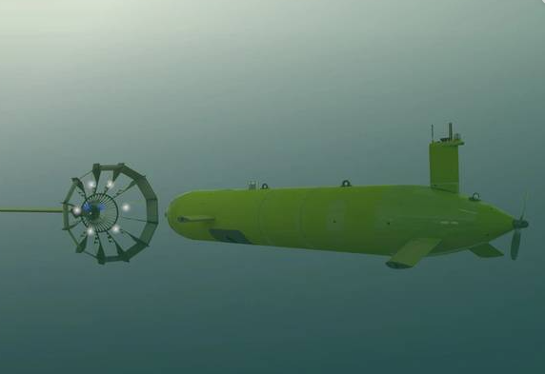
INTRODUCTION
Autonomous Underwater Vehicles
Underwater Docking
Underwater Challenges
Drawbacks of Traditional Method
Advantages of Vision-Based Approach
Pose Estimation For AUV Guidance
Figure 1: Docking of an AUV

Slide 4
MOTIVATION
In response to the challenges of operating in the deep ocean, our project is motivated by the urgent need for efficient underwater docking solutions.
Improvement of efficiency and safety of underwater docking operations
Increment of the operational range of AUVs
Minimization of reliance on human intervention
Enabling support for innovative underwater applications

Slide 5
LITERATURE REVIEW
SL No | PAPER TITLE | AUTHORS | TECHNIQUES USED | RESULTS | DRAWBACKS (if any)
1 | YOLO Object Detection Using OPENCV [1] | Akshara Gupta, Aditya Verma,Aditya Yadav,Arvidhan M | CNN , YOLO | This paper gives a efficient approach for image detection using YOLO in OpenCV | Yolo is a good detection algorithm but the accuracy in complex environment like underwater condition may get drastically hampered
2 | Underwater Object Detection and Tracking [2] | Divya Priyadarshini, MaheshKumar H. Kolekar | Object Detection, Computer Vision | The proposed methodology in this paper achieves higher precision compared to traditional techniques, regardless of image or video frame resolution and clarity. | Algorithm cannot read RGB image. Image necessarily needs to be a gray image for detecting the object.
3 | Underwater Object Classification and Detection [3] | Andre Jesus, Claudio Zito, Claudio Tortorici, Eloy Roura, Giulia De Masi | Yolo V3, Faster RCNN | This paper's key contribution is to analyze and quantify the shortcomings of conventional state-of-the-art algorithms for object detection in underwater environments. | Underwater prediction may deteriorate on harsh and muddy water.

Slide 6
contd...
SL No | PAPER TITLE | AUTHORS | TECHNIQUES USED | RESULTS | DRAWBACKS (if any)
4 | Estimation of Positions and Poses of Autonomous Underwater Vehicle Relative to Docking Station Based on Adaptive Extraction of Visual Guidance Features | Fengtian Lv, Huixi Xu, Kai shi, Xiaohui Wang | YOLO, Faster RCNN, Docking Neural Network (DoNN) | Experimental results demonstrated less than 10% absolute estimation error for each degree of freedom in the PPARD.The new extraction method achieved an 87.99% success rate, surpassing classical methods. | For real time underwater scenarios, the output may get hampered.
5 | Detection and Pose Estimation for Short-Range Vision-Based Underwater Docking | SHUANG LIU , METE OZAY , TAKAYUKI OKATANI, HONGLI XU, KAI SUN, YANG LIN | CNN, YOLO, R-CNN, Fast-RCNN, Faster R-CNN | For robust and credible detection of docking stations, a CNN called docking neural network (DoNN)is used. For accurate pose estimation, a perspective-n-point algorithm is integrated into the framework | The limitations of this research include the framework's sensitivity to strong artificial noise, untested performance in diverse real-world underwater conditions.
6 | Pose estimation for the case of prolonged under ice based AUV | D Frolov , S Polovko | Computer vision, Control System. | Provides a system for determining the relative position based on cameras and active-light markers. A system equation and a complete mathematical modeling for the positioning system is performed. | The absence of empirical testing in authentic under-ice conditions hinders the assessment of the system's practical viability and robustness.

Slide 7
PROBLEMS FORMULATED
Phase 01
01
Efficient Underwater Docking Station Detection with limited dataset using Transformer based object detection.
Phase 02
02
Pose Estimation of the Docking Station for proper and accurate docking of the Autonomous Underwater Vehicle (AUV).

Slide 8
WORK DONE
UNDERWATER DOCKING STATION DETECTION

Slide 9
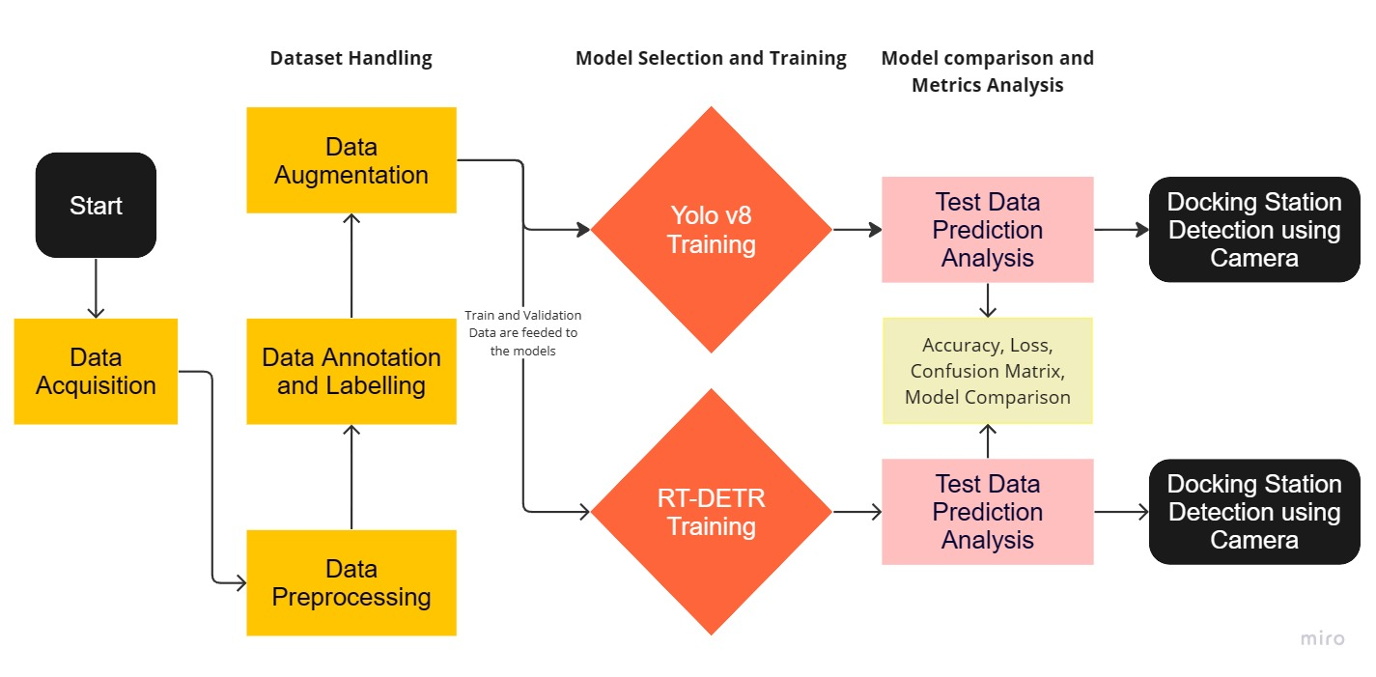
BLOCK DIAGRAM
Underwater Docking Station Detection
‹#›

Slide 10
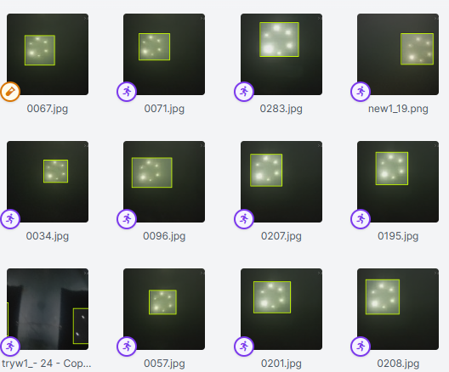
METHODOLOGY
Underwater Docking Station Detection
STEP 1 : Data Collection and Annotation
Figure 2: Dataset Handling and Annotation
‹#›

Slide 11
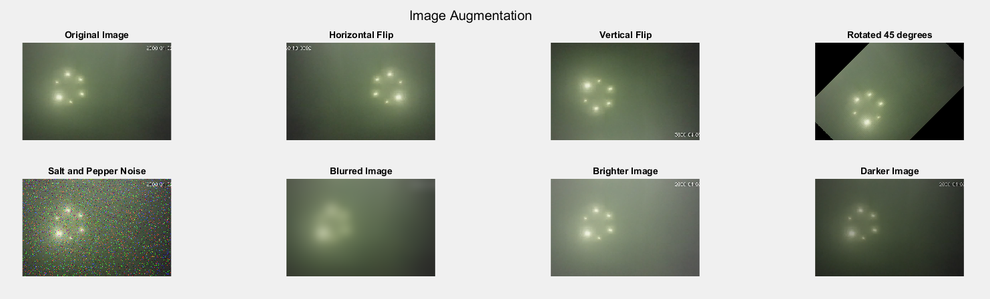
METHODOLOGY (contd…)
Underwater Docking Station Detection
STEP 2 : Data Augmentation
Figure 3: Example of Data Augmentation
‹#›

Slide 12
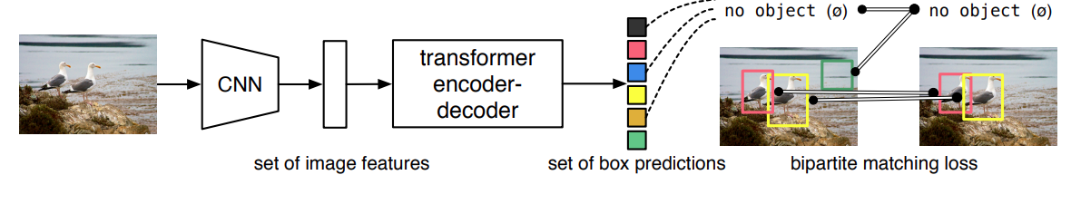
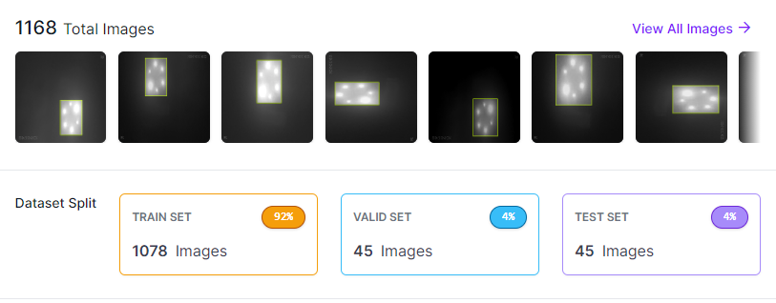
METHODOLOGY(contd…)
METHODOLOGY (contd…)
Underwater Docking Station Detection
Underwater Docking Station Detection
DATASET:
Total 450 images are used, annotated and labeled using RoboFlow.
Preprocessing : Resize (640 x 640) & Grayscale
Augmentation : Rotation, Flip, shear, Noise, Blur etc.
The Augmented images are splitted into three sets:
Training Set : 1078 images
Validation Set : 45 images
Test Set : 45 images
RT - DETR :
Real-Time Detection Transformer (RT-DETR) is a state-of-the-art object detection algorithm that leverages the power of transformers in the field of Object Detection.
Future Proof Technology
Beats most of the state of the art technologies like YOLO in terms of accuracy.
Figure 3: Structure of Detection Transformer
Figure 4: Dataset used
‹#›

Slide 13
METHODOLOGY (contd…)
Underwater Docking Station Detection
STEP 3 : Vision Model Implementation
Here we have used two state of the art models
You Only Look Once (YOLO v8 )
Real Time Detection Transformer ( RT-DETR )
‹#›

Slide 14
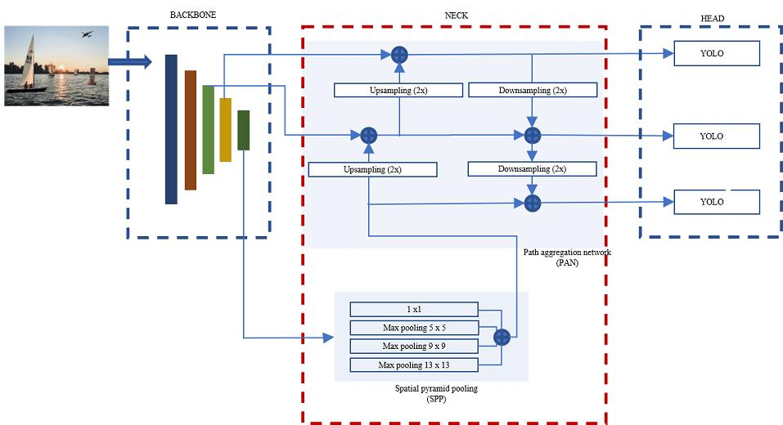
METHODOLOGY(contd…)
Underwater Docking Station Detection
YOLO v8 :
YOLO (You Only Look Once) stands out for its speed and accuracy.
YOLO directly predicts bounding boxes and class probabilities from an image, bypassing the complex two-stage architecture of traditional object detection methods.
YOLO version 8 is faster Compared to R-CNN, SSD, Faster R-CNN and earlier versions of Yolo
Figure 5: Structure of Yolo

Slide 15
METHODOLOGY(contd…)
Underwater Docking Station Detection
RT - DETR :
Real-Time Detection Transformer (RT-DETR) is a state-of-the-art object detection algorithm that leverages the power of transformers in the field of Object Detection.
Future Proof Technology
Beats most of the state of the art technologies like YOLO in terms of accuracy.
Figure 6: Structure of Detection Transformer

Slide 16
POSE ESTIMATION OF THE DOCKING STATION

Slide 17
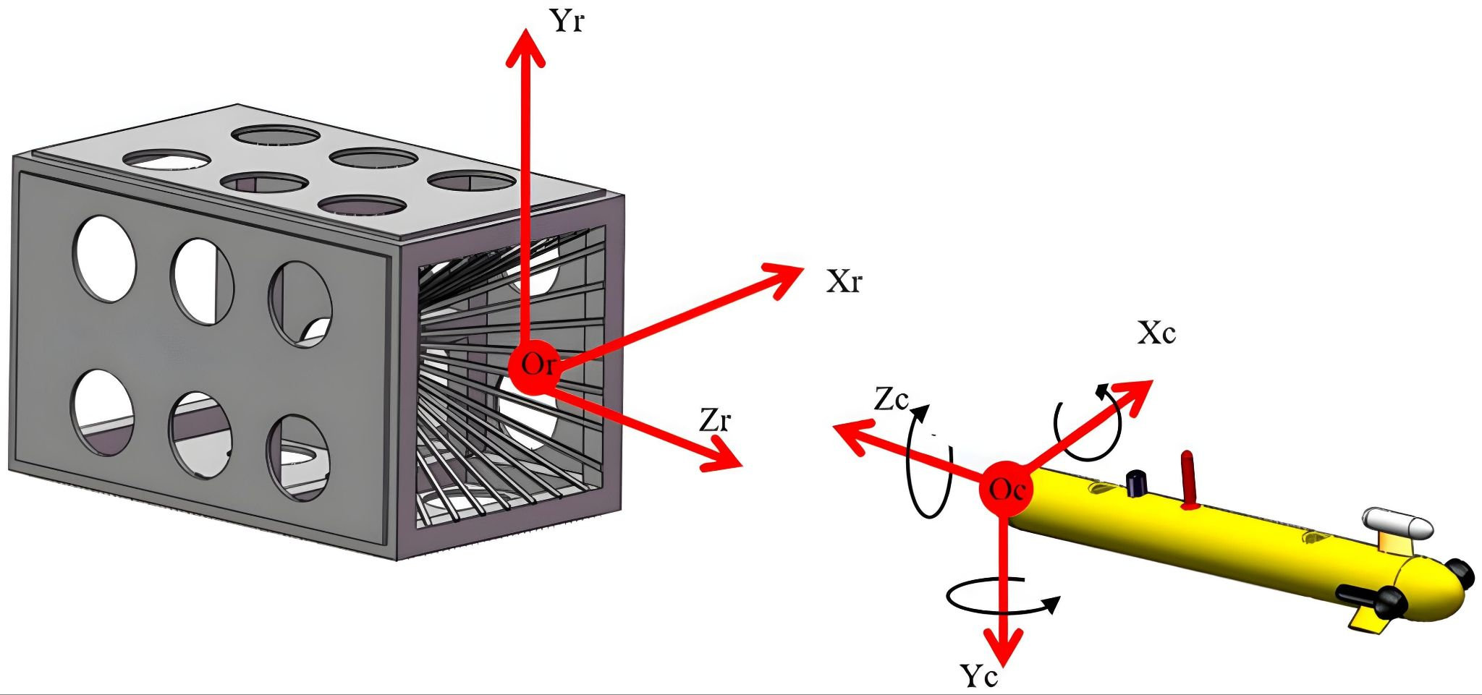
Pose Estimation
Pose Estimation
Importance of Pose Estimation
Benefits of accurate Pose Estimation
Challenges in underwater Pose Estimation
Figure 7: AUV calculating the center of the docking station

Slide 18
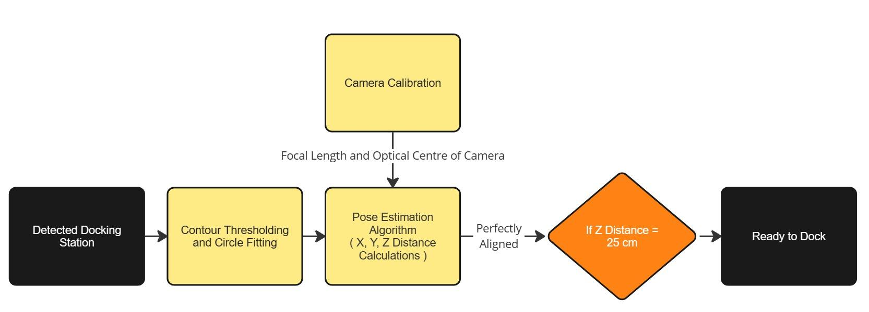
BLOCK DIAGRAM
Pose Estimation
X = 0 cm and Y = 0 cm
‹#›

Slide 19
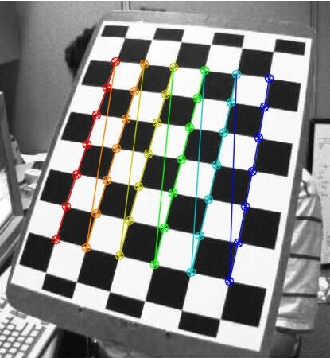
METHODOLOGY(contd…)
STEP 1 : Camera Calibration
Used to find intrinsic and extrinsic properties ( focal length, optical centre, etc ) of the camera.
Using these properties for distance measurement, distortion removal and other purposes.
Checkerboard pattern used for Camera Calibration.
Thus focal length and Optical Centre of the camera is determined.
Figure 8: Checkerboard pattern

Slide 20
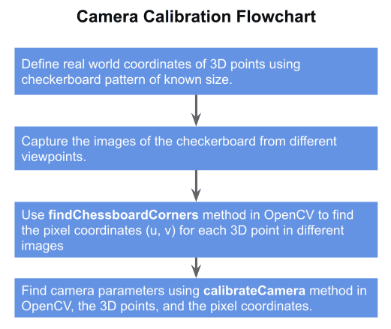
METHODOLOGY(contd…)
STEP 1 : Camera Calibration
Figure 9: Flowchart of camera calibration

Slide 21
METHODOLOGY(contd…)
STEP 2 : Implementation of pose estimation algorithm
Thresholding and Contour Detection
Circle Fitting over the contours
Calculating Z distance (in meters):
Z_distance = (focal length * actual_diameter) / perceived_diameter
Calculating X and Y distance (in meters):
X_distance = (X_distance in pixel * actual diameter) / perceived_diameter
Y_distance = (Y_distance in pixel * actual diameter) / perceived_diameter
Visualization and Guidance
Recommendation about docking status

Slide 22
RESULTS

Slide 23
RESULTS(contd…)
Docking Station Detection
YOLO v8 | RT-DETR
The model is trained for 50 epochs Class Loss : 0.4425 Recall : 0.959 mAP50 (Mean Average Precision at IoU threshold 0.5): 0.971 mAP50-95 (Mean Average Precision over IoU thresholds 0.5 to 0.95): 0.661 | The model is trained for 50 epochs Class Loss : 0.3566 Recall : 1 mAP50 (Mean Average Precision at IoU threshold 0.5): 0.978 mAP50-95 (Mean Average Precision over IoU thresholds 0.5 to 0.95): 0.653

Slide 24
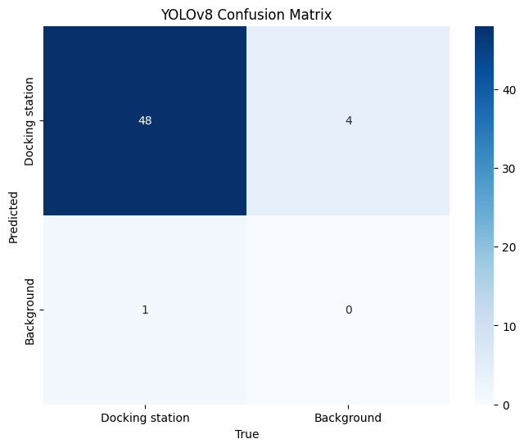

RESULTS(contd…)
YOLO v8 | RT-DETR

Slide 25
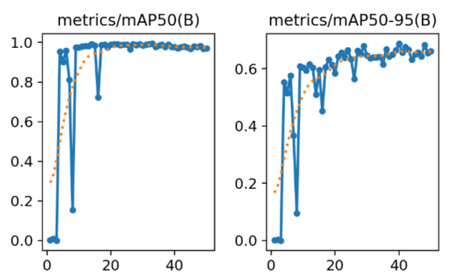
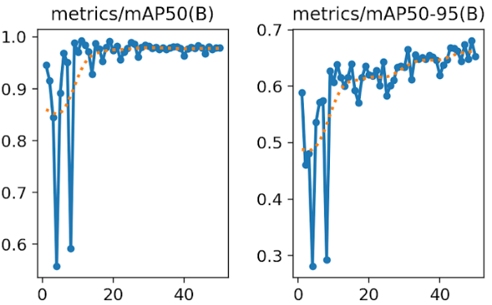
RESULTS(contd…)
YOLO v8 | RT-DETR
‹#›

Slide 26
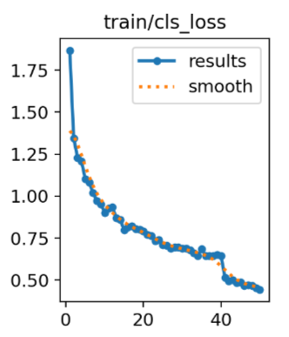
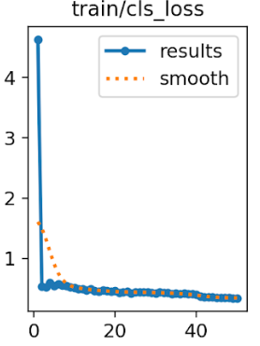
RESULTS(contd…)
YOLO v8 | RT-DETR
‹#›

Slide 27
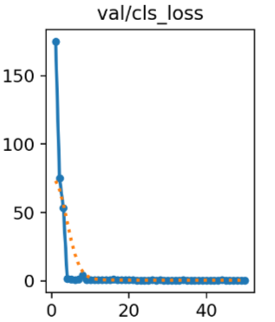
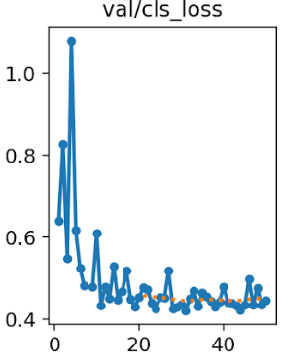
RESULTS(contd…)
YOLO v8 | RT-DETR
‹#›

Slide 28
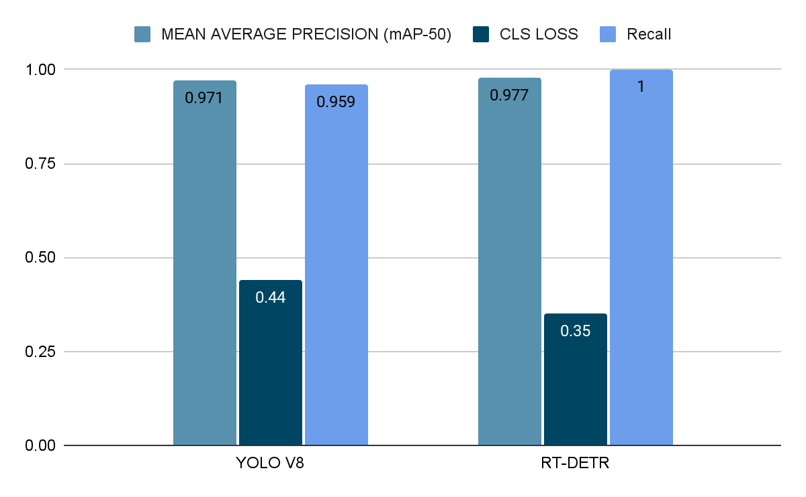
RESULTS(contd…)

Slide 29
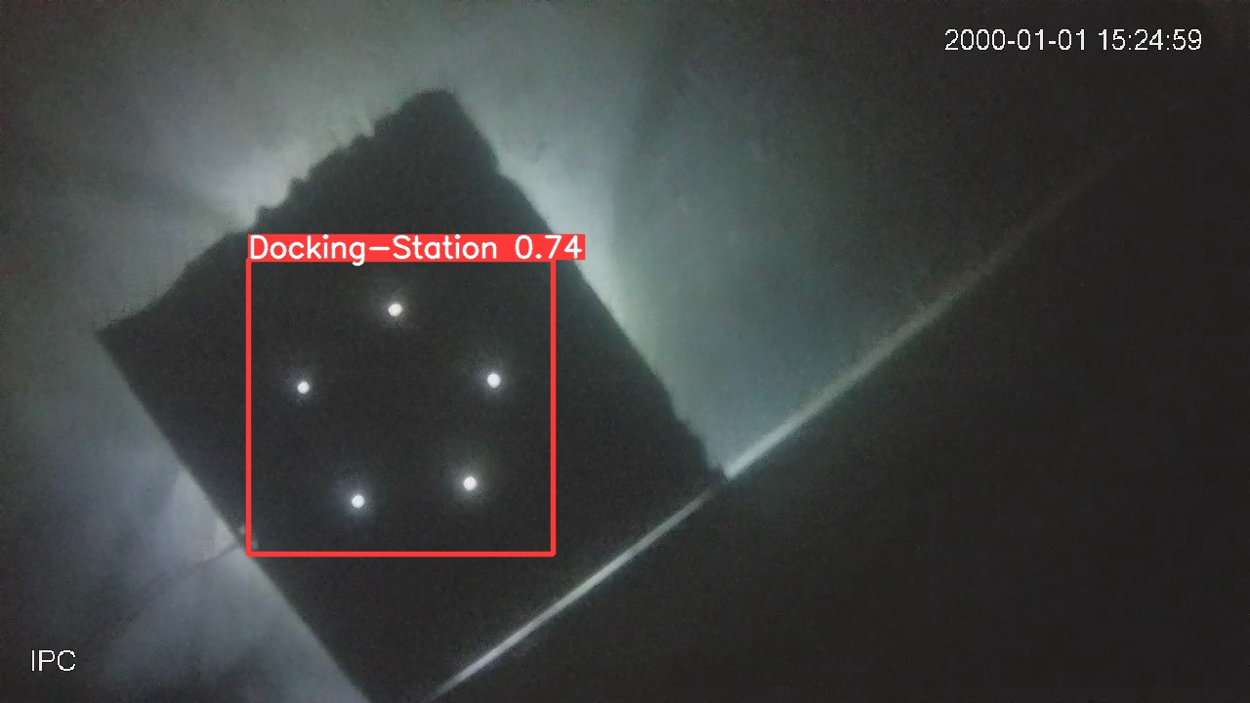
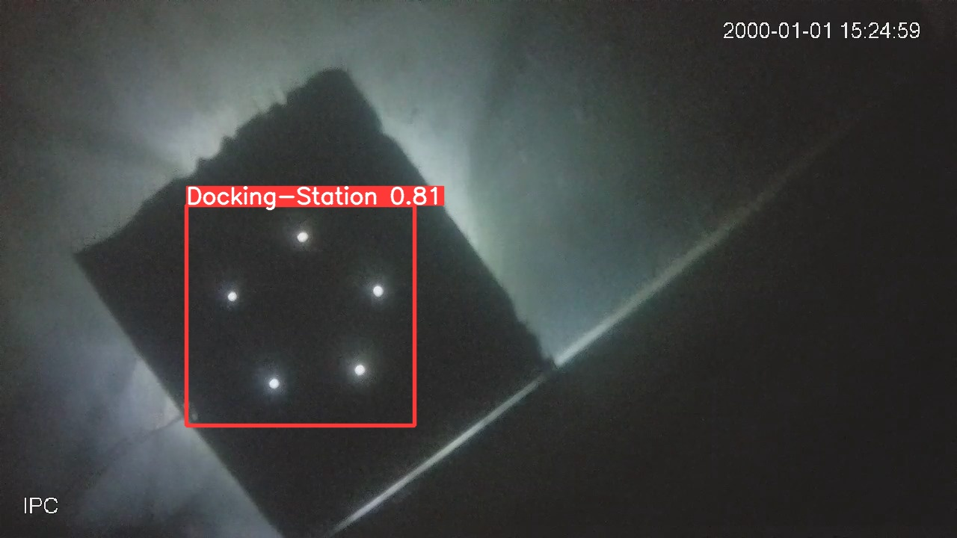
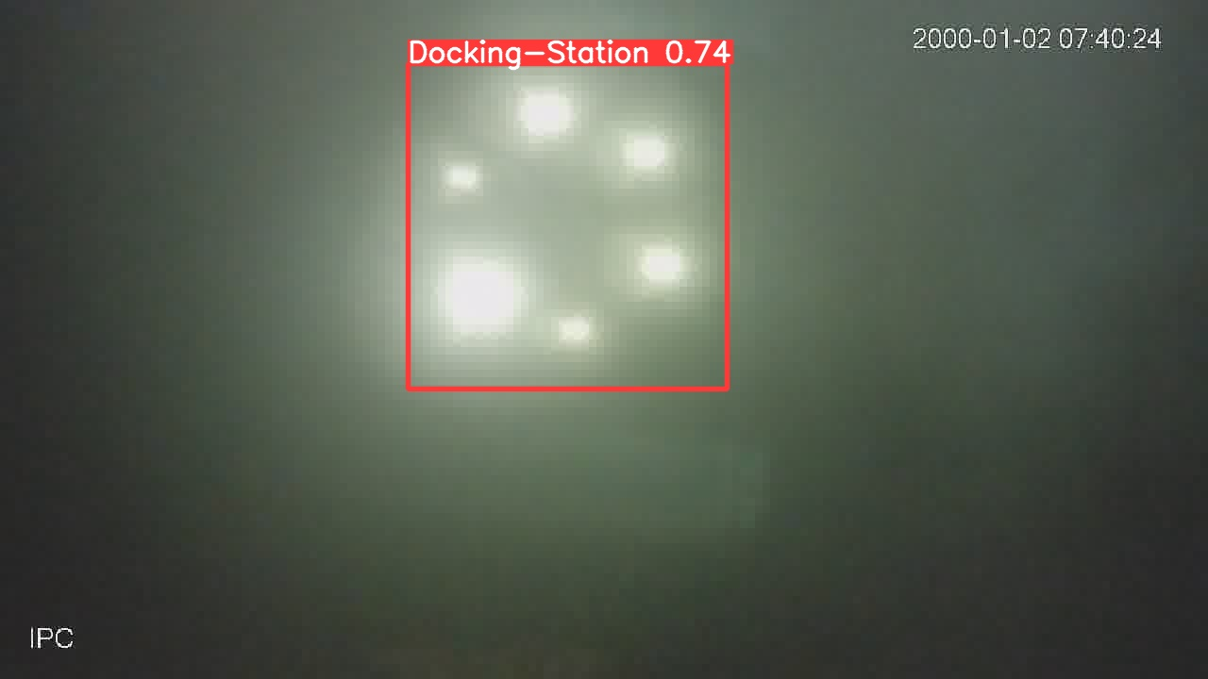
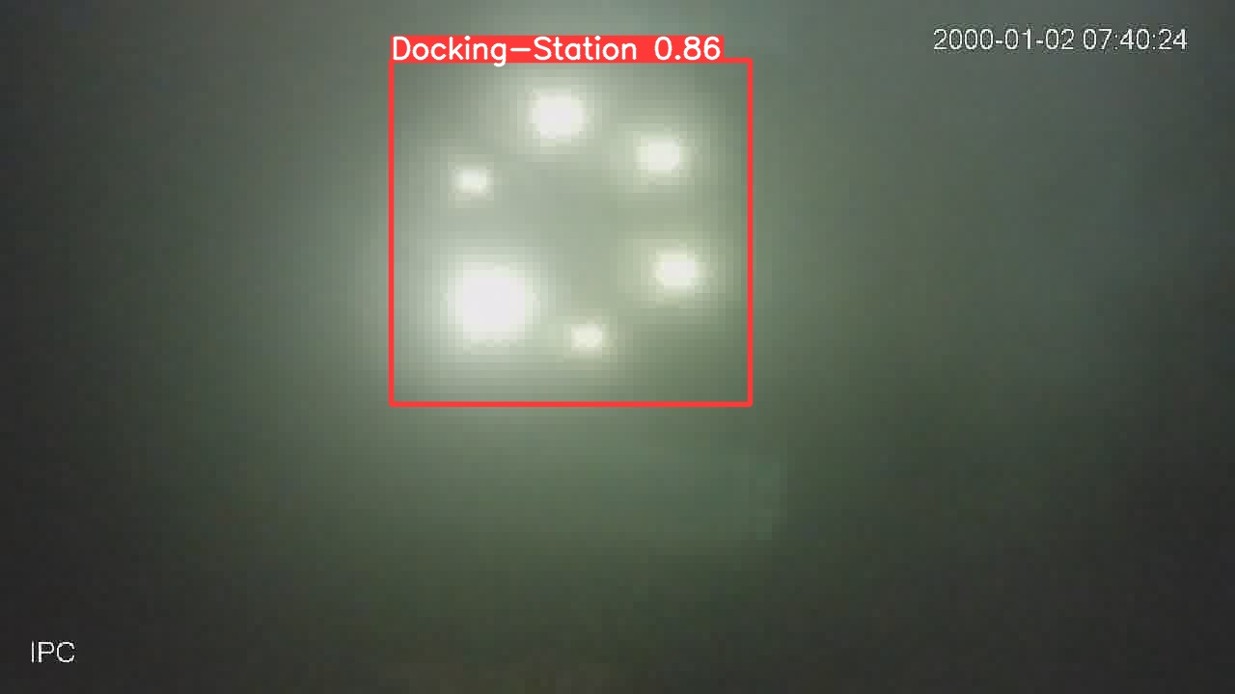
RESULTS(contd…)
YOLO v8 | RT-DETR
Real Time Prediction Result : | Real Time Prediction Result :

Slide 30
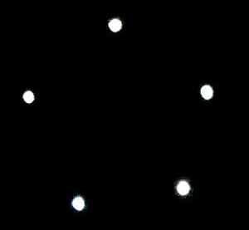
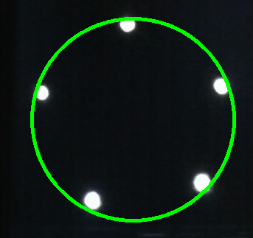
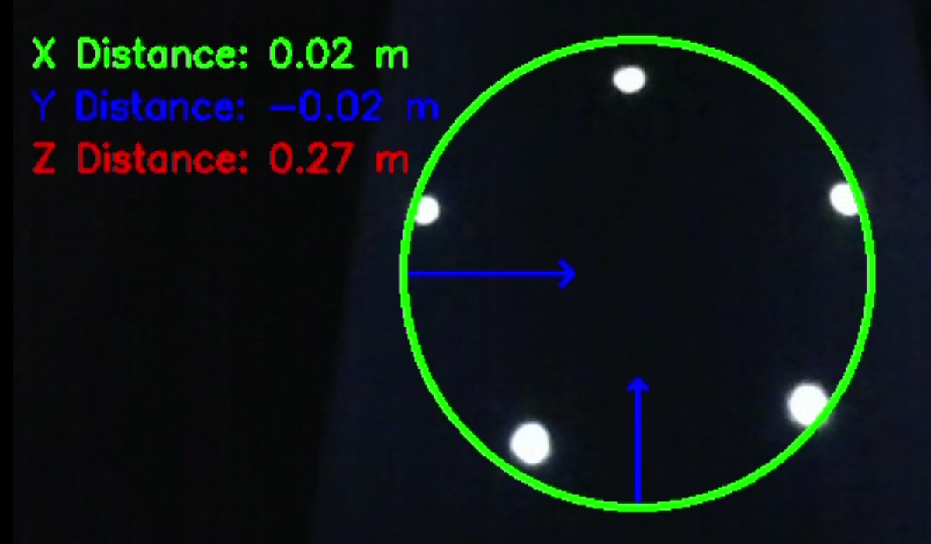
RESULTS(contd…)
3D Pose Estimation
Calculated Focal Length = 809.408 pixels
Thresholding /Contour Detection Circle Fitting X, Y, Z distances
Figure 10: Contour detection
Figure 11: Circle fitting over the contour
Figure 12: Displaying X,Y and Z distances

Slide 31
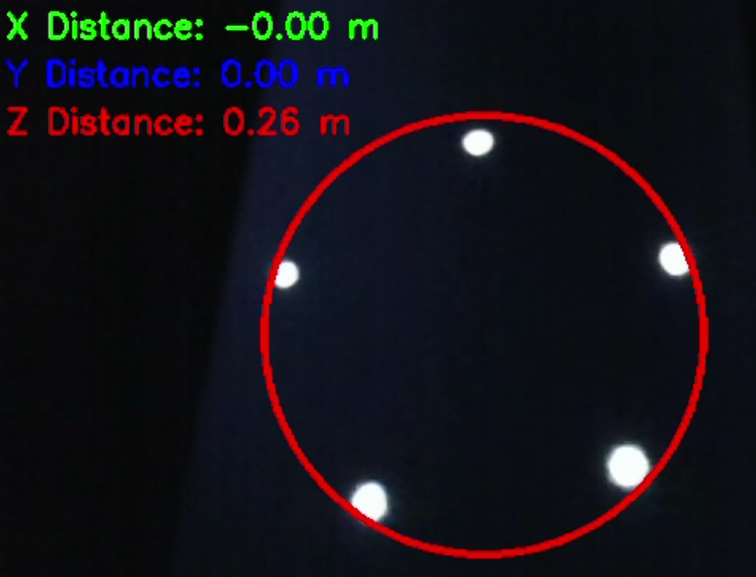
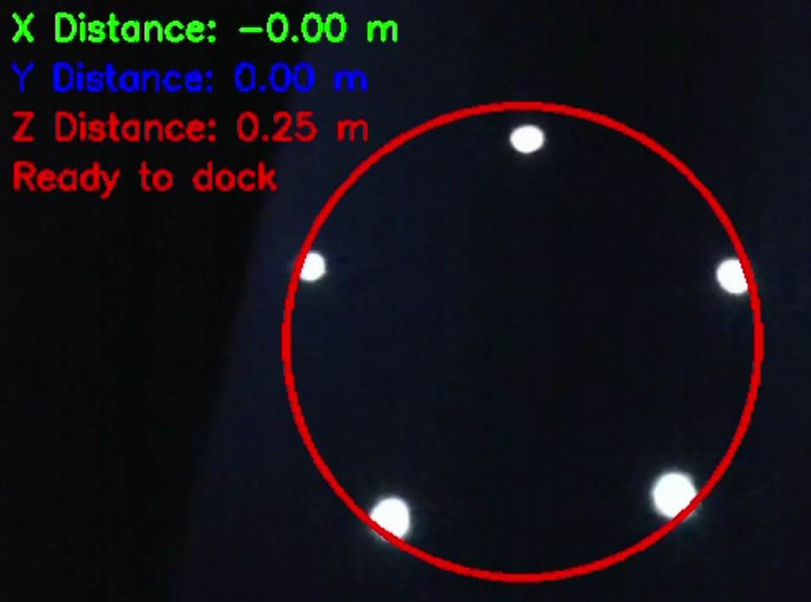
RESULTS(contd…)
When Optical Centre is Perpendicular
to the Centre of the Docking station
Ready to Dock at a distance equal to 0.25 m
Figure 13: Perfectly aligned
Figure 14: Ready to dock

Slide 32
RESULTS(contd…)
Axis | Actual Distance (cm) | Calculated Distance (cm) | Percentage Error (%)
X | 2.5 | 3 | 20
 | 3.5 | 4 | 14
 | 4.5 | 5 | 11
Y | 2.7 | 3 | 11
 | 3.7 | 4 | 8
 | 4.7 | 5 | 6
Z | 24 | 25 | 4
 | 25 | 26 | 4
 | 26 | 27 | 3.8
Percentage error = (actual distance - calculated distance)/actual distance * 100%

Slide 33
CONCLUSION
RT-DETR Model exceeds over YOLO v8 in terms of Recall and Precision.
Real Time Detection of the Docking Station with good accuracy.
Implementation of pose estimation algorithm.
Achieved guidance about movement of AUV for perfect docking.
Achieved recommendation about docking status.
An average error of 2% can be observed in distance measurement.

Slide 34
PERT CHART
Literature Review of previous works, Beginning of the Phase 1 of the project
Study of Phase II : Pose estimation algorithm and its implementation using openCV
Fine tuning of the overall project.
Oct - Dec 2023
May-June 2024
August- September 2023
Feb- Mar 20244
June 2024
Implementation of the Object Detection Algorithm using YOLOv8 and RT-DETR
Implementation of Pose Estimation Algorithm

Slide 35
LIMITATIONS AND FUTURE DIRECTION
Integration of Hardware Setup.
Optimization of the models used for better performance.
Expansion of training dataset in varied environments.
The Pose Estimation Algorithm is currently tested above water. Next work will be focused on underwater conditions.
Optimisation of the pose estimation algorithm for error reduction.

Slide 36
REFERENCES
[1] Gupta, Akshara, Aditya Verma, and A. Yadav. "YOLO OBJECT DETECTION USING OPENCV." International Journal of Engineering Applied Sciences and Technology 5.10, 2021.
[2] D. Priyadarshni, M. Kolekar. "Underwater Object Detection and Tracking," , pp. 837-846, 2020.
[3] J. Redmon, S. K. Divvala, R. B. Girshick, and A. Farhadi, “You only look once: Unified, real-time object detection,” CoRR, vol. abs/1506.02640, 2015.
[4] N. Carion, F. Massa, G. Synnaeve, N. Usunier, A. Kirillov, and S. Zagoruyko, “End-to-end object detection with transformers,” 2020.
[5] W. Lv, S. Xu, Y. Zhao, G. Wang, J. Wei, C. Cui, Y. Du, Q. Dang, and Y. Liu, “Detrs beat yolos on real-time object detection,” arXiv preprint arXiv:2304.08069, 2023.
[6] S. Liu, M. Ozay, T. Okatani, H. Xu, K. Sun and Y. Lin, "Detection and Pose Estimation for Short-Range Vision-Based Underwater Docking," in IEEE Access, vol. 7, pp. 2720-2749, 2019
[7] v, Fengtian, Huixi Xu, Kai Shi, and Xiaohui Wang. 2022. "Estimation of Positions and Poses of Autonomous Underwater Vehicle Relative to Docking Station Based on Adaptive Extraction of Visual Guidance Features" Machines 10, no. 7: 571
[8] K. Yamashita et al., "Improvement of 3D Pose Estimation Abilities by Light-Emitting-3D Marker for AUV Docking,"

Slide 37
THANK YOU

